Slide 1

Data Communication and Networking (DCAN 202)
Week 2
Kent Institute Australia Pty. Ltd.
ABN 49 003 577 302 CRICOS Code: 00161E RTO Code: 90458 TEQSA Provider Number: PRV12051
Version 2 – 18th December 2015

Slide 2
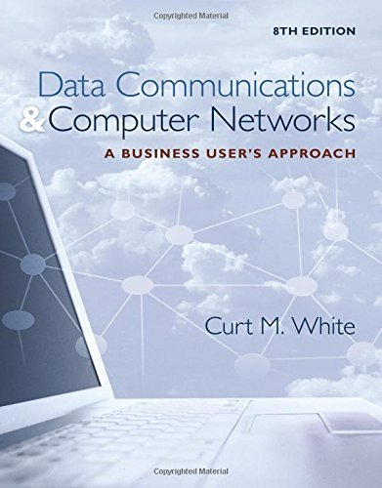
Chapter 2: Fundamentals of Data and Signals
Data Communications and Computer Networks: A Business User's Approach, Eighth Edition
© 2016. Cengage Learning. All right reserved.

Slide 3
Todays Lecture
Difference between data and signals
Three basic components of a signal
Bandwidth of a signal
how it relates to data transfer speed
Signal strength and attenuation
Basic characteristics of transmitting analog data with analog signals, digital data with digital signals, digital data with analog signals, and analog data with digital signals

Slide 4
Todays Lecture
Basic digital encoding techniques
Various shift keying (modulation) techniques
Common digitization techniques
Different data codes and how they are used in communication systems

Slide 5
Introduction
Data are entities that convey meaning (computer files, music on CD, results from a blood gas analysis machine)
Signals are the electric or electromagnetic encoding of data (telephone conversation, web page download)
Computer networks and data/voice communication systems transmit signals
Data and signals can be analog or digital

Slide 6
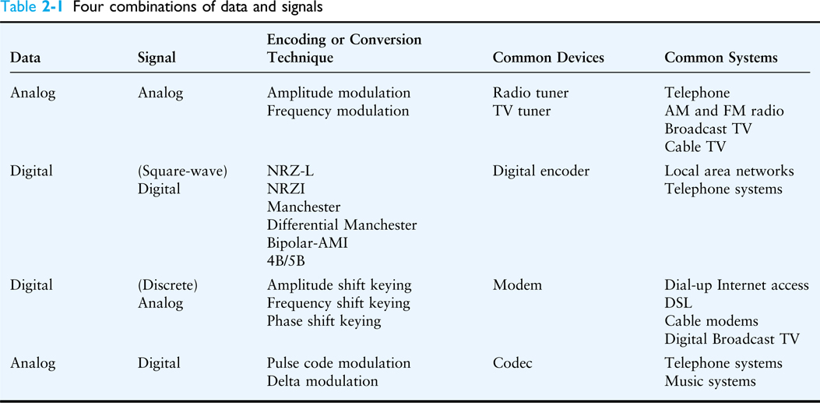
Introduction
Source: Data Communications and Computer Networks: A Business User's Approach, Eighth Edition
© 2016. Cengage Learning. All right reserved.
Four Combinations of data and signals

Slide 7
Data and Signals
Data are entities that convey meaning within a computer or computer system
Signals are the electric or electromagnetic impulses used to encode and transmit data

Slide 8
Analog vs Digital
Data and signals can be either analog or digital
Analog is a continuous waveform, with examples such as (naturally occurring) music and voice
It is harder to separate noise from an analog signal than it is to separate noise from a digital signal (see the following two slides)

Slide 9
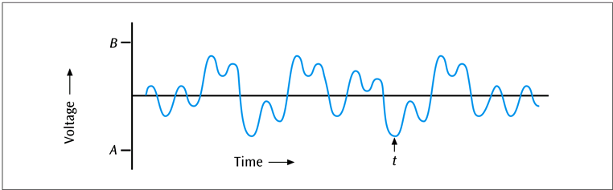
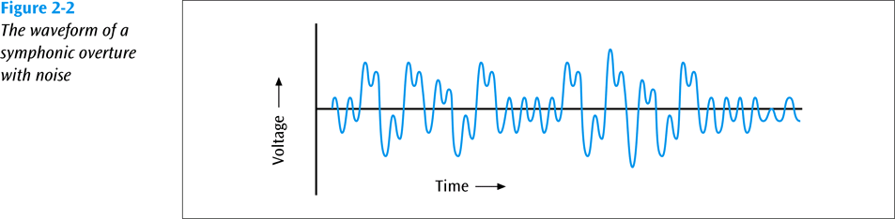
Analog vs Digital
A simple example of an analog waveform
Source: Data Communications and Computer Networks: A Business User's Approach, Eighth Edition
© 2016. Cengage Learning. All right reserved.
The waveform of a symphonic overture with noise

Slide 10
Analog vs Digital
Digital is a discrete or non-continuous waveform
Something about the signal makes it obvious that the signal can only appear in a fixed number of forms (see next slide)
Noise in digital signal
You can still discern a high voltage from a low voltage
Too much noise – you cannot discern a high voltage from a low voltage

Slide 11
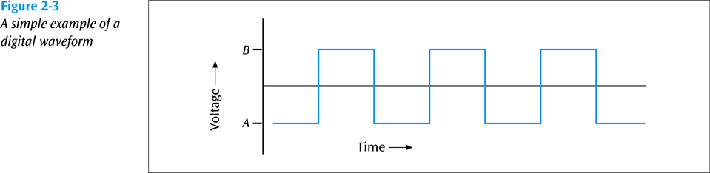
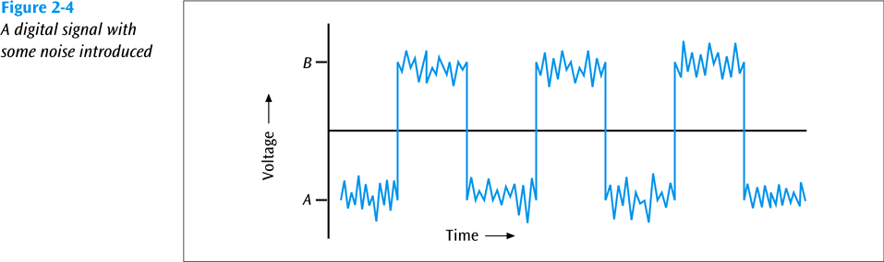
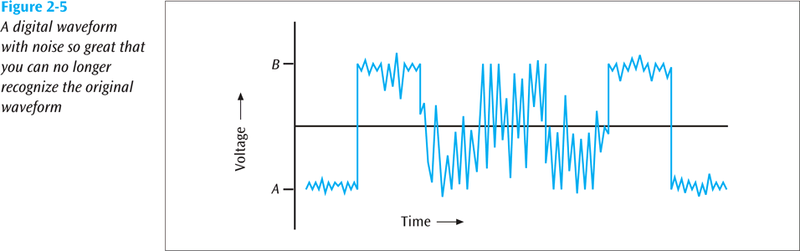
Analog vs Digital
A simple example of an digital waveform
Source: Data Communications and Computer Networks: A Business User's Approach, Eighth Edition
© 2016. Cengage Learning. All right reserved.
A digital signal with some noise introduced
A digital waveform with noise so great that you can no longer recognise the original waveform

Slide 12
Fundamentals of Signals
All signals have three components:
Amplitude
Frequency
Phase

Slide 13
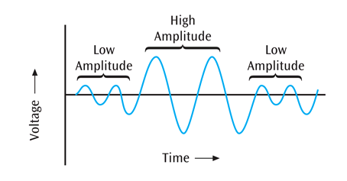
Fundamentals of Signals – Amplitude
Amplitude
The height of the wave above or below a given reference point
Amplitude is usually measured in volts
Source: Data Communications and Computer Networks: A Business User's Approach, Eighth Edition
© 2016. Cengage Learning. All right reserved.
Signal with two different amplitudes

Slide 14
Fundamentals of Signals – Frequency
Frequency
The number of times a signal makes a complete cycle within a given time frame; frequency is measured in Hertz (Hz), or cycles per second (period = 1 / frequency)
Spectrum – Range of frequencies that a signal spans from minimum to maximum
Bandwidth – Absolute value of the difference between the lowest and highest frequencies of a signal
For example, consider an average voice
The average voice has a frequency range of roughly 300 Hz to 3100 Hz
The spectrum would be 300 – 3100 Hz
The bandwidth would be 2800 Hz

Slide 15
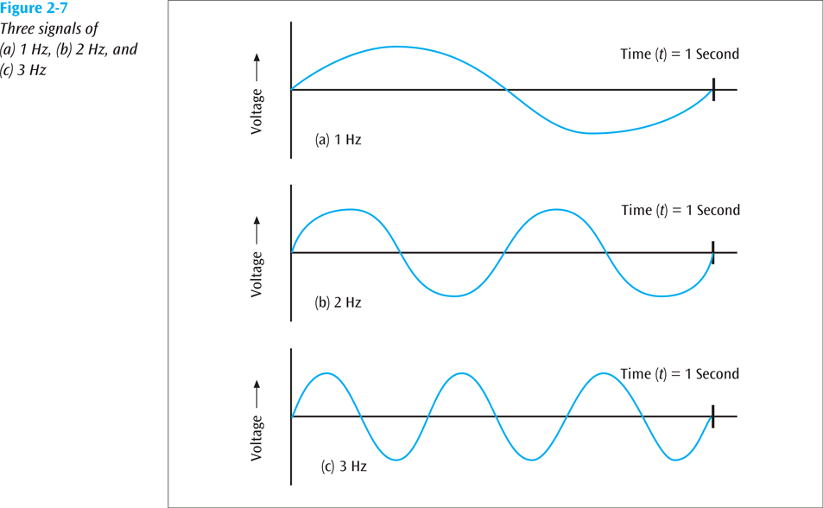
Fundamentals of Signals – Frequency
Source: Data Communications and Computer Networks: A Business User's Approach, Eighth Edition
© 2016. Cengage Learning. All right reserved.
Three signals of (a) 1 Hz, (b) 2 Hz, and (c) 3 Hz

Slide 16
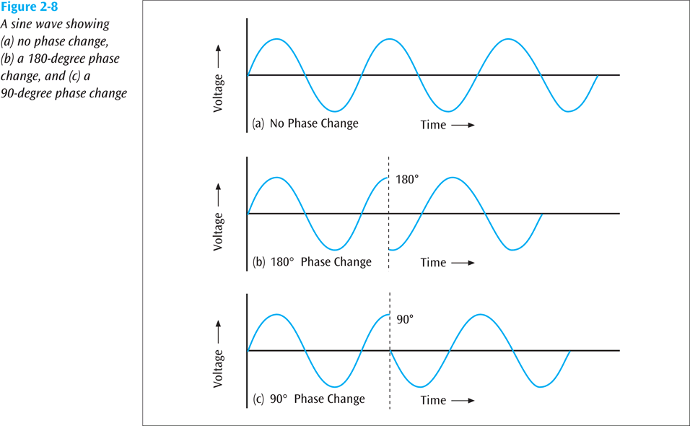
Fundamentals of Signals – Phase
Phase
The position of the waveform relative to a given moment of time or relative to time zero
A change in phase can be any number of angles between 0 and 360 degrees
Phase changes often occur on common angles, such as 45, 90, 135, etc.
Source: Data Communications and Computer Networks: A Business User's Approach, Eighth Edition
© 2016. Cengage Learning. All right reserved.
A sine wave showing: (a) no phase change (b) a 180-degree phase change, and (c) a 90-degree phase change

Slide 17
Fundamentals of Signals – Phase
Phase
If a signal can experience two different phase angles, then 1 bit can be transmitted with each signal change (each baud)
If a signal can experience four different phase angles, then 2 bits can be transmitted with each signal change (each baud)
Note: number of bits transmitted with each signal change = log₂ (number of different phase angles)
(You can replace “phase angles” with “amplitude levels” or “frequency levels”)

Slide 18
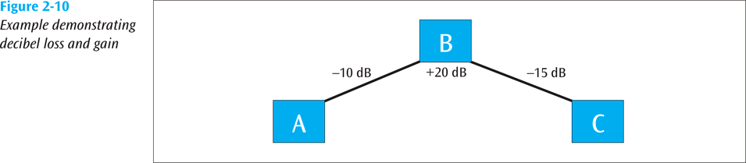
Loss of Signal Strength
All signals experience loss (attenuation)
Attenuation is denoted as a decibel (dB) loss
Decibel losses (and gains) are additive
Example demonstrating decibel loss and gain

Slide 19
Loss of Signal Strength (continued)
Formula for decibel (dB):
dB = 10 x log₁₀ (P₂ / P₁)
where P₁ is the beginning power level and P₂ is the ending power level

Slide 20
Loss of Signal Strength (continued)
So if a signal loses 3 dB, is that a lot?
What if a signal starts at 100 watts and ends at 50 watts? What is dB loss?
dB = 10 x log₁₀ (P₂ / P₁)
dB = 10 x log₁₀ (50 / 100)
dB = 10 x log₁₀ (0.5)
dB = 10 x -0.3
dB = -3.0
So a 3.0 decibel loss losses half of its power

Slide 21
Converting Data into Signals
There are four main combinations of data and signals:
Analog data transmitted using analog signals
Digital data transmitted using digital signals
Digital data transmitted using discrete analog signals
Analog data transmitted using digital signals
Let’s look at each these

Slide 22
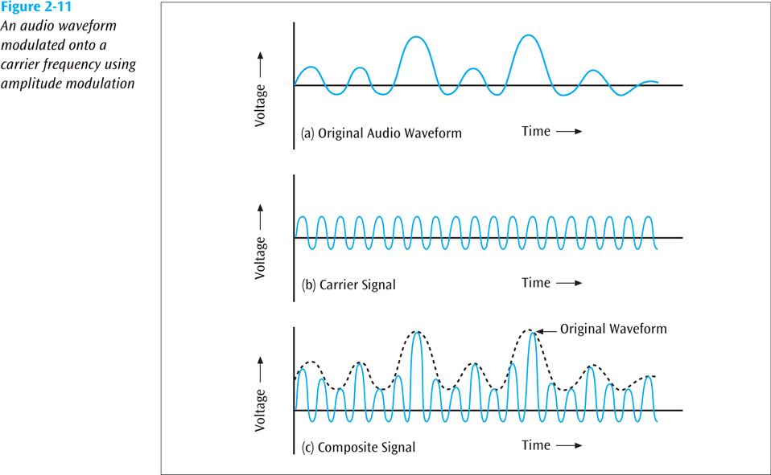
1. Transmitting Analog Data with Analog Signals
In order to transmit analog data, you can modulate the data onto a set of analog signals
Broadcast radio and the older broadcast television are two very common examples of this
We modulate the data onto another set of frequencies so that all the different channels can coexist at different frequencies
Source: Data Communications and Computer Networks: A Business User's Approach, Eighth Edition
© 2016. Cengage Learning. All right reserved.
An audio waveform modulated onto a carrier frequency using amplitude modulation

Slide 23
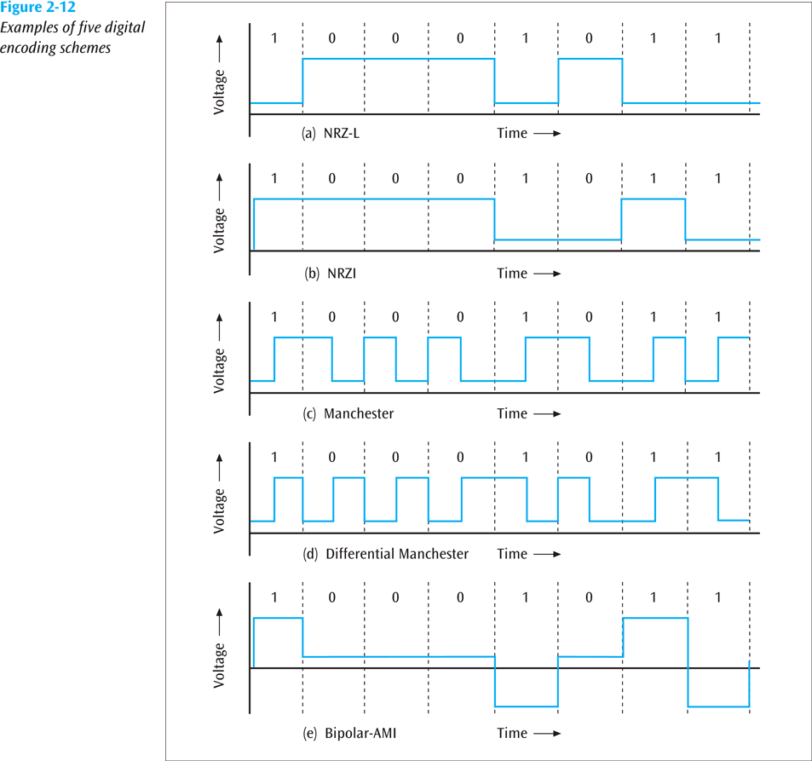
2. Transmitting Digital Data with Digital Signals: Digital Encoding Schemes
There are numerous techniques available to convert digital data into digital signals. Let’s examine five:
NRZ-L
NRZI
Manchester
Differential Manchester
Bipolar AMI
These are used in LANs and some telephone systems
Source: Data Communications and Computer Networks: A Business User's Approach, Eighth Edition
© 2016. Cengage Learning. All right reserved.
Examples of 5 digital encoding schemes

Slide 24
Non-return to Zero Digital Encoding Schemes
Non-return to zero-level (NRZ-L) transmits 1s as zero voltages and 0s as positive voltages
Non-return to zero inverted (NRZI) has a voltage change at the beginning of a 1 and no voltage change at the beginning of a 0
Fundamental difference exists between NRZ-L and NRZI
With NRZ-L, the receiver has to check the voltage level for each bit to determine whether the bit is a 0 or a 1,
With NRZI, the receiver has to check whether there is a change at the beginning of the bit to determine if it is a 0 or a 1

Slide 25
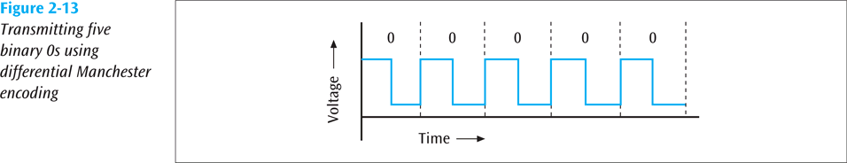
Manchester Digital Encoding Schemes
Note how with a Differential Manchester code, every bit has at least one significant change. Some bits have two signal changes per bit (baud rate = twice bps)
Source: Data Communications and Computer Networks: A Business User's Approach, Eighth Edition
© 2016. Cengage Learning. All right reserved.
Transmitting five binary 0s using differential Manchester encoding

Slide 26
Bipolar-AMI Encoding Scheme
The bipolar-AMI encoding scheme is unique among all the encoding schemes because it uses three voltage levels
When a device transmits a binary 0, a zero voltage is transmitted
When the device transmits a binary 1, either a positive voltage or a negative voltage is transmitted
Which of these is transmitted depends on the binary 1 value that was last transmitted

Slide 27
4B/5B Digital Encoding Scheme
Yet another encoding technique; this one converts four bits of data into five-bit quantities
The five-bit quantities are unique in that no five-bit code has more than 2 consecutive zeroes
The five-bit code is then transmitted using an NRZI encoded signal

Slide 28
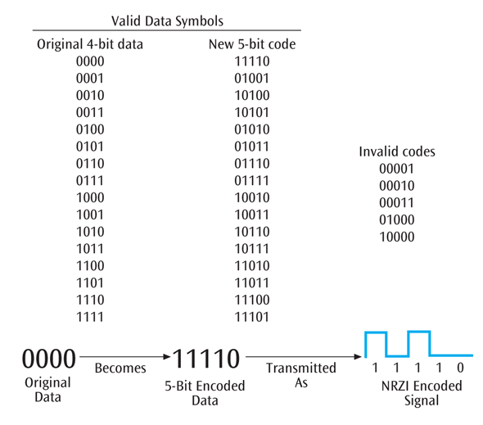
4B/5B Digital Encoding Scheme (continued)
Source: Data Communications and Computer Networks: A Business User's Approach, Eighth Edition
© 2016. Cengage Learning. All right reserved.
The 4B/5B digital encoding scheme

Slide 29
3. Transmitting Digital Data with Discrete Analog Signals
Three basic techniques:
Amplitude shift keying
Frequency shift keying
Phase shift keying
One can then combine two or more of these basic techniques to form more complex modulation techniques (such as quadrature amplitude modulation)

Slide 30
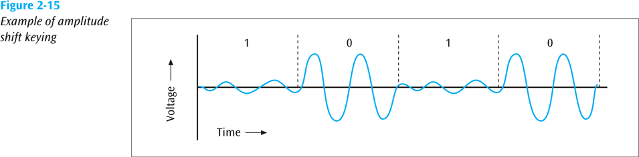
Amplitude Shift Keying
In amplitude shift keying, the amplitude of the carrier signal is varied to create signal elements. Both frequency and phase remain constant while the amplitude changes.
One amplitude encodes a 0 while another amplitude encodes a 1 (a form of amplitude modulation)
Example of amplitude shift keying

Slide 31
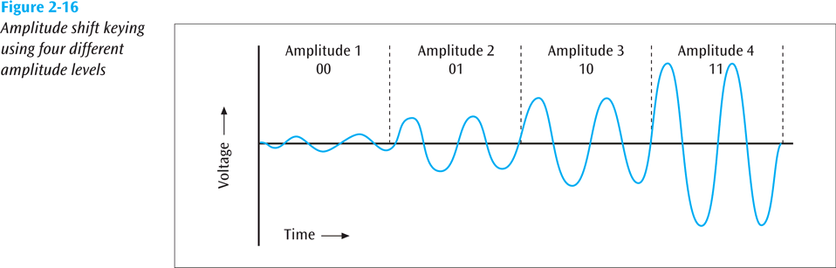
Amplitude Shift Keying (continued)
Here we have four different amplitudes, so we can encode 2 bits in each signal change (bits per signal change = log₂ (amplitude levels)).
Source: Data Communications and Computer Networks: A Business User's Approach, Eighth Edition
© 2016. Cengage Learning. All right reserved.
Amplitude shift keying using four different amplitude levels

Slide 32
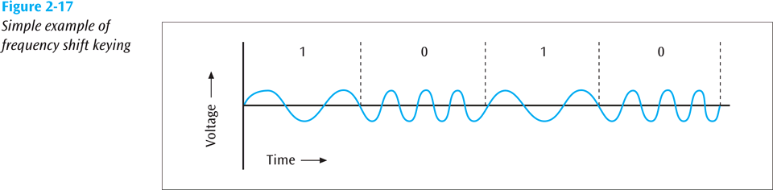
Frequency Shift Keying
In frequency shift keying, the frequency of the carrier signal is varied to represent data.
One frequency encodes a 0 while another frequency encodes a 1 (a form of frequency modulation)
Source: Data Communications and Computer Networks: A Business User's Approach, Eighth Edition
© 2016. Cengage Learning. All right reserved.
Example of frequency shift keying

Slide 33
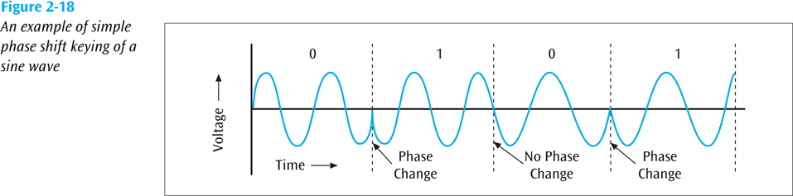
Phase Shift Keying
In phase shift keying, the phase of the carrier is varied to represent two or more different signal elements. Both peak amplitude and frequency remain constant as the phase changes. Today, PSK is more common than ASK or FSK
One phase change encodes a 0 while another phase change encodes a 1 (a form of phase modulation)
Source: Data Communications and Computer Networks: A Business User's Approach, Eighth Edition
© 2016. Cengage Learning. All right reserved.
Example of Phase shift keying of a sine wave

Slide 34
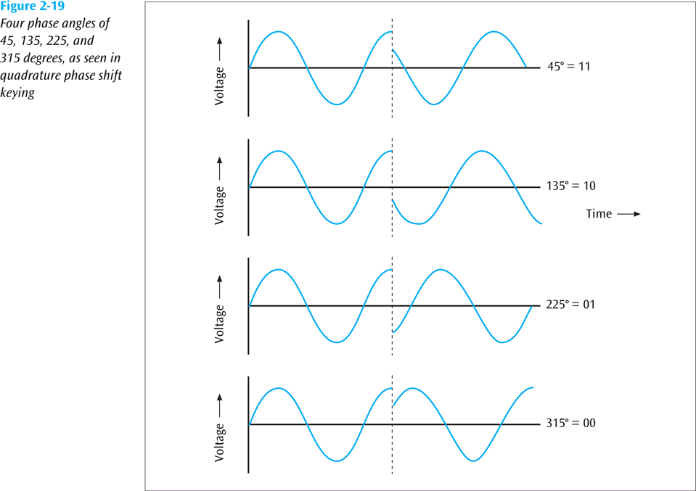
Phase Shift Keying (continued)
Quadrature Phase Shift Keying
Four different phase angles used
45 degrees
135 degrees
225 degrees
315 degrees
Source: Data Communications and Computer Networks: A Business User's Approach, Eighth Edition
© 2016. Cengage Learning. All right reserved.
Four phase angles of 45, 135, 225, and 315 degrees, as seen in quadrature phase shift keying

Slide 35
4. Transmitting Analog Data with Digital Signals
To convert analog data into a digital signal, there are two techniques:
Pulse code modulation (the more common)
Delta modulation

Slide 36

Pulse Code Modulation
The most common technique used to change an analog signal to digital data (digitization) is called pulse code modulation (PCM).
A PCM encoder has three processes:
1. Sampling 2. Encoding 3. Quantizing
https://www.youtube.com/watch?v=HlGJ6xxbz8s

Slide 37
Pulse Code Modulation (continued)
Since telephone systems digitize human voice, and since the human voice has a fairly narrow bandwidth, telephone systems can digitize voice into either 128 or 256 levels
These are called quantization levels
If 128 levels, then each sample is 7 bits (2 ^ 7 = 128)
If 256 levels, then each sample is 8 bits (2 ^ 8 = 256)
How fast do you have to sample an input source to get a fairly accurate representation?
Nyquist says 2 times the highest frequency
Thus, if you want to digitize voice (4000 Hz), you need to sample at 8000 samples per second

Slide 38
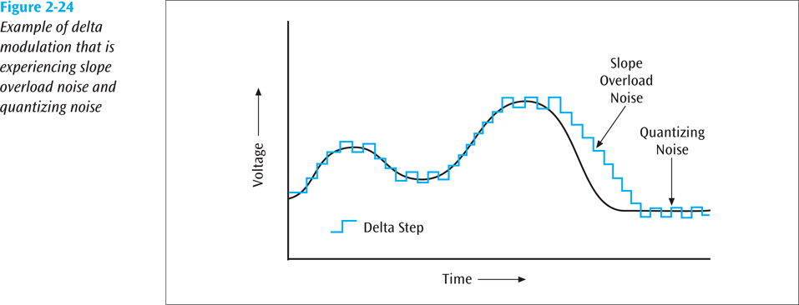
Delta Modulation
An analog waveform is tracked, using a binary 1 to represent a rise in voltage, and a 0 to represent a drop
Source: Data Communications and Computer Networks: A Business User's Approach, Eighth Edition
© 2016. Cengage Learning. All right reserved.
Example of delta modulation that is experiencing slope overload noise and quantising noise

Slide 39
The Relationship Between Frequency and Bits Per Second
Higher Data Transfer Rates
How do you send data faster?
Use a higher frequency signal (make sure the medium can handle the higher frequency
Use a higher number of signal levels
In both cases, noise can be a problem

Slide 40
The Relationship Between Frequency and Bits Per Second (continued)
Maximum Data Transfer Rates
How do you calculate a maximum data rate?
Use Shannon’s equation
S(f) = f x log₂ (1 + S/N)
Where f = signal frequency (bandwidth), S is the signal power in watts, and N is the noise power in watts
For example, what is the data rate of a 3400 Hz signal with 0.2 watts of power and 0.0002 watts of noise?
S(f) = 3400 x log₂ (1 + 0.2/0.0002) = 3400 x log₂ (1001) = 3400 x 9.97 = 33898 bps

Slide 41
Data Codes
Computers use numbers. They store characters by assigning a number for each one.
The set of all textual characters or symbols and their corresponding binary patterns is called a data code
There are three common data code sets:
EBCDIC :
ASCII
Unicode

Slide 42
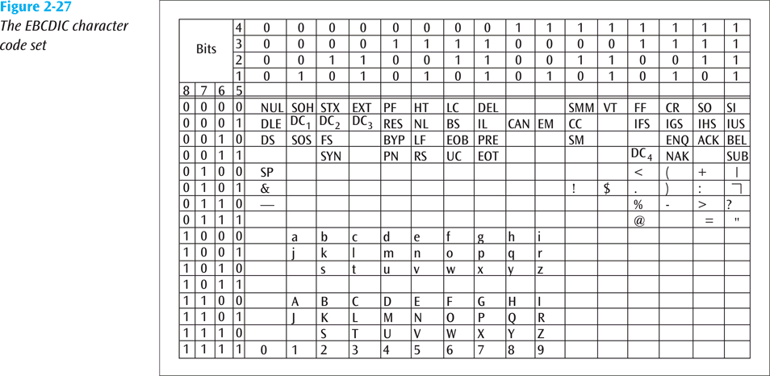
EBCDIC
An 8-bit character code developed and used by IBM.
Source: Data Communications and Computer Networks: A Business User's Approach, Eighth Edition
© 2016. Cengage Learning. All right reserved.
EBCDIC character code set

Slide 43
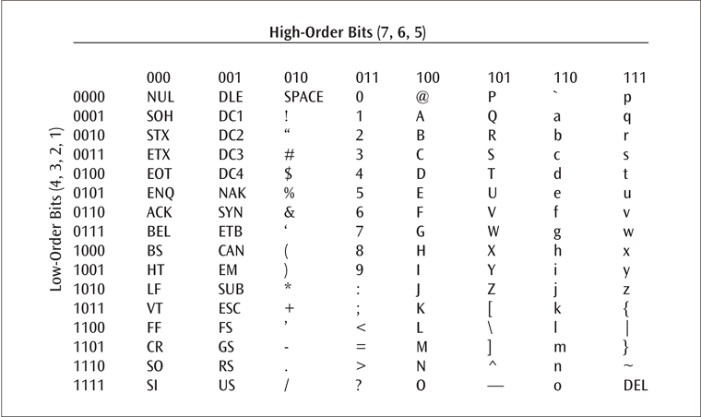
ASCII
The American Standard Code for Information Interchange (ASCII) is a 7-bit code that was designed to provide code for 128 symbols, mostly in American English. Today, ASCII, or Basic Latin, is part of Unicode. It occupies the first 128 codes in Unicode (00000000 to 0000007F).
Source: Data Communications and Computer Networks: A Business User's Approach, Eighth Edition
© 2016. Cengage Learning. All right reserved.
ASCII character set

Slide 44
Unicode
Each character is 16 bits
A large number of languages / character sets
For example:
T equals 0000 0000 0101 0100
r equals 0000 0000 0111 0010
a equals 0000 0000 0110 0001

Slide 45
Data and Signal Conversions In Action: Two Examples
Let us transmit the message “Sam, what time is the meeting with accounting? Hannah.”
This message leaves Hannah’s workstation and travels across a local area network

Slide 46
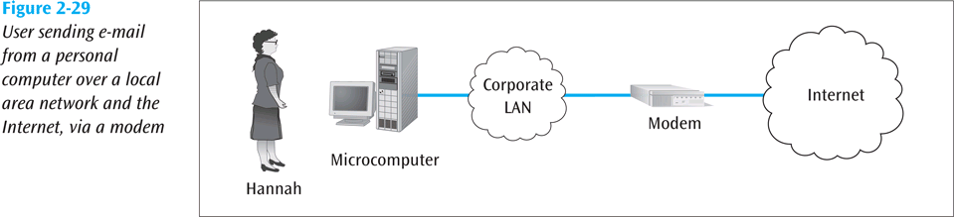
Data and Signal Conversions In Action: Two Examples (continued)
Source: Data Communications and Computer Networks: A Business User's Approach, Eighth Edition
© 2016. Cengage Learning. All right reserved.
User sending e-mail from a personal computer over a local area network and the internet, via a modem

Slide 47
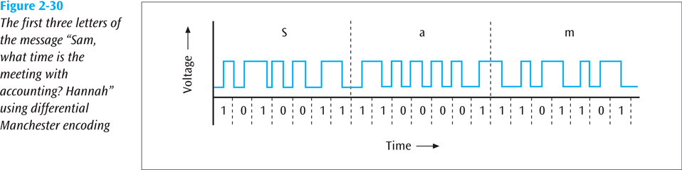
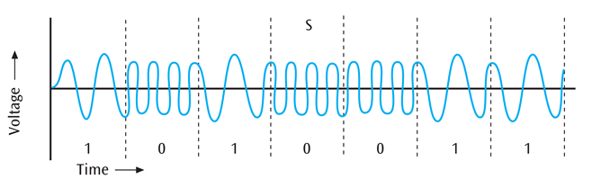
Data and Signal Conversions In Action: Two Examples (continued)
The first 3 letters of the message “Sam, what time is the meeting with accounting? Hannah” using differential Manchester encoding
Source: Data Communications and Computer Networks: A Business User's Approach, Eighth Edition
© 2016. Cengage Learning. All right reserved.
Frequency modulated signal for the letter “S”

Slide 48
Summary
Data and signals are two basic building blocks of computer networks
All data transmitted is either digital or analog
Data is transmitted with a signal that can be either digital or analog
All signals consist of three basic components: amplitude, frequency, and phase
Two important factors affecting the transfer of a signal over a medium are noise and attenuation
Four basic combinations of data and signals are possible: analog data converted to an analog signal, digital data converted to a digital signal, digital data converted to a discrete analog signal, and analog data converted to a digital signal

Slide 49
Summary
To transmit analog data over an analog signal, the analog waveform of the data is combined with another analog waveform in a process known as modulation
Digital data carried by digital signals is represented by digital encoding formats
For digital data to be transmitted using analog signals, digital data must first undergo a process called shift keying or modulation
Three basic techniques of shift keying are amplitude shift keying, frequency shift keying, and phase shift keying

Slide 50
Summary
Two common techniques for converting analog data so that it may be carried over digital signals are pulse code modulation and delta modulation
Data codes are necessary to transmit the letters, numbers, symbols, and control characters found in text data
Three important data codes are ASCII, EBCDIC, and Unicode

Slide 51

kent.edu.au Kent Institute Australia Pty. Ltd. ABN 49 003 577 302 ● CRICOS Code: 00161E ● RTO Code: 90458 ● TEQSA Provider Number: PRV12051

